Slide 1
Code Day
Pitch Deck
Notes:
Selling Doc
User stories from people on why this is worthwhile
Why is code day valuable?
Air cover
Peanut butter policy

Slide 2

Outline
Background
Code Day Objectives
Successes and Accomplishments
Operations
Planning
Funding/Finances
Issues and Opportunities

Slide 3
Background
Code Day is a chance for civil servants to step outside their normal workflow to focus on analytical or digital projects with a community of like-minded colleagues.
Participants spend a full-day working on their own projects or learning new methods(self driven hackathon.
Through independent or group work, they get to know a broad community of experts to learn from and collaborate with — even after Code Day.
What does Analytics mean to us?
The discovery, interpretation and communication of significant patterns in data. A key component in evidence based policy making
Presenting summary statistics in a easy and usable way in interactive dashboards that tell a policy story
Use Statistics Modeling & Machine Learning enables new insights, better targeting of programs, and creates a richer evidence base for decisions.
Providing analysis from a centralized repository to keep data consistency and reduce time spent looking for specific numbers
What does Digital mean to us?
The use of digital methods in policy making.
Automating manual data entry processes in Excel using Python/VBA/R
Behavioral Insights & User Experience to inform the way we craft tools and policies to better address our user needs. Our users are PSE stakeholders, Ministry executives, and Ministry staff.
Collaborating digitally using software and tools (i.e. Slack, GitHub, Agile Methods, and SharePoint) to help improve project management and productivity.
Notes:
Self Guided Hackathon
Google 80/20 rule

Slide 4
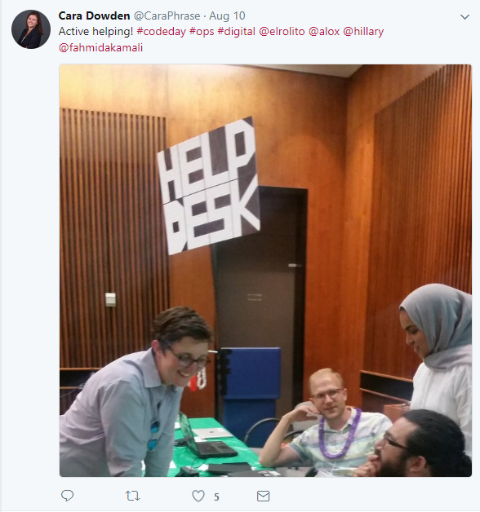
Code Day Event Model
5 Code Days were held in 2017
MAESD Code Day – 12 Participants (January)
MMA/MHO Code Day – 20 Participants (March)
MAESD Code Day 2 – 50 Participants (May)
OPS Mega Code Day – 140 Participants (August)
MAESD Code Day Festivus Edition – 30 Participants (December)
Partners for Code Day Planning
Policy Innovation Hub
MAESD Analytics Unit
MAESD FPSPU
MCSS Analytics
MOI/MOH
Ontario Digital Service
TBS – Open Data
Notes:
Stress in this slide that it is NOT JUST US thinking this way
Central agencies are fully supportive of our work
We are not doing this in a vacuum

Slide 5
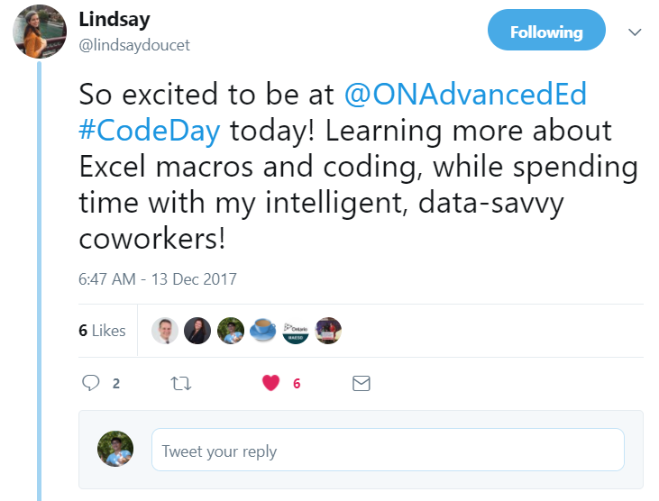
Objectives – High Level
MAESD EXECUTIVE POLICY ON DIGITAL GOVERNMENT & DATA GOVERNANCE
Sharing data within legislative authority to improve service delivery to citizens of Ontario.
Facilitating and enhancing the Ministry’s ability to make informed decisions and recommendations.
Improving the accuracy and timeliness of Ministry data.
Deriving maximum business benefit from information and technology.
Increasing system effectiveness and efficient access to data.
How does Code Day Help With this Policy?
Creating space for dedicated work/project time
Building a Community of Analytics
Helping guide people in their quest in learning about a digital and analytical mindset
Notes:
To be as open and inclusive as possible

Slide 6
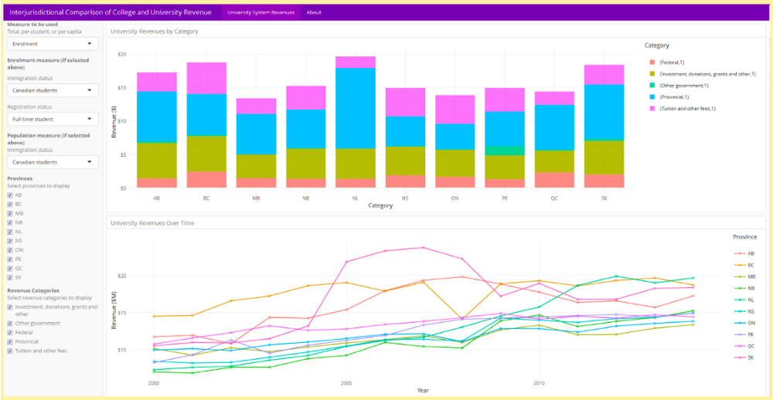
Objective - Creating space for dedicated work/project time
Digital products can be in bringing better information to users, inside or outside government, with greater efficiency.
Developing digital products, whether they’re analytical models, web apps or database scripts, is challenging and often requires undisturbed “flow.”
However, the challenge working in a government environment is that flow tends to be challenging due to the nature of the work in policy.
Code Day fixed this by providing time and space where all employees can come and work undisturbed.
This is a data dashboard that shows the
Interjurisdictional Comparison of revenue for Universities and colleges in Canada
This was worked on and built during a Code
Day and
Automates and munges the data to give meaningful analysis (from a process that would take a week or more to a 5 second script run every year)
Created a centralize place to get this analysis
Notes:
Asher’s interjuristictional
Being intentional about work

Slide 7
Objective - Co-Creation and Co-Working
General:
Data Literacy for Policy Enthusiasts Framework
Learning R-Shiny for Data Visualizations
OPS:
Positive Space – Registration Page
Transitioning the Ontario Public Service Pride Network website to TBS intranet website standards
MAESD Specific:
Mapping Out SMA Data Flow Process
Massaging SMA Workbook Data for Dashboard Visualizations
CIP Mapping for Colleges
College Finance Analysis (Exploring different visualizations for revenues, expenses, trends)
Improvements to the Long Term PSE Enrolment Forecast
University Key Performance Indicators Data Visualizations
Student Transitions from K-12 to PSE (Data Clean Up)
College and University Finance Related – Mapping data elements to new funding formula
MIRR Specific:
Web scrapping off INAC and Health Canada websites to create community profile reports/dashboards
“Code day was a fun opportunity to improve my web development skills while getting to know fellow coders. It’s a great way for busy OPSers to learn new skills or find ways to do things more efficiently.”
~Meagan Cameron
Notes:
(get matt to write this slide about the session they ran at mega code day

Slide 8
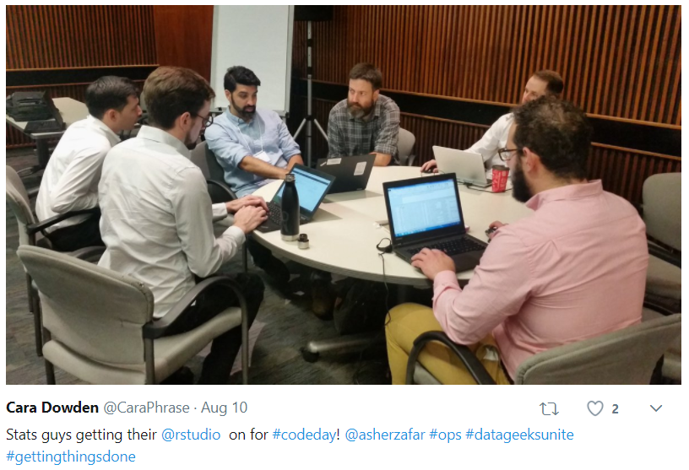
Objective - Building a Community in Digital Methods and Analytics
When an individual is doing data and digital work in traditional policy unit, there is a general feeling that they are not surrounded by peers that understand the type of work they do.
Code Day tried to rectify this by providing these individuals with a place to meet others that do the same time of work.
For example, The Funding Policy and System Planning Unit has now made connections all over the OPS, City of Toronto and Government of Canada that do digital and analytical work
“It was really great, I had an incredibly happy team coming back after code day, looking forward to the next one, and pumped about the contacts they made during the day.”
~ Christine Hagyard
Notes:
IMSB/ FPSPU collaboration project <- OEN
Cross Pollination

Slide 9
Operational Details
Volunteer Coordination
Space
Food
Website Setup
Marketing
Sample Agenda
9:30am - 10:00am
Opening remarks
Icebreaker game
Introductions (including your project for the day)
10:00am - 12:30pm
Work on your project (either independently or collaboratively - ask for help!)
12:30pm - 1:30pm
(Working) Lunch
1:30pm - 3:00pm
Collaborate some more
3:00pm - 4:00pm
Show & Tell
Closing Remarks

Slide 10
Success stories
Automation story
Vis story
Increase capacity story
Python into Excel
Notes:
TOM

Slide 11
Issues and Opportunities
Attrition (several staff left after lunch).
Staff reluctance in some cases to share results (for accountability purposes).
Dedicated time (some staff continued to be engaged on work related issues).
Measuring staff output can come at odds if part of the time is intended to be spent networking and learning from peers.
Some managers felt that the communication regarding the event was overly restricted to explicit coding work.

Slide 12
Resources

Slide 13
What if I'm not a coder or data analyst?
Do you want to learn how to use a data analysis or coding tool? Bring that as your project! Maybe you have colleagues that are more technical, and you want to work with them on building something. Plan your project together!
Will there be training and tutoring available?
There will be no formal training, however, there will be links to great self-directed learning resources you can pursue, and communication tools set up to ask your colleagues questions on anything you need help with.
None of us are experts on everything - ask your colleagues for help! You'll also be placed at a table with colleagues who want to work with similar tools and projects, but feel free to move around.

Slide 14
